Slide 1
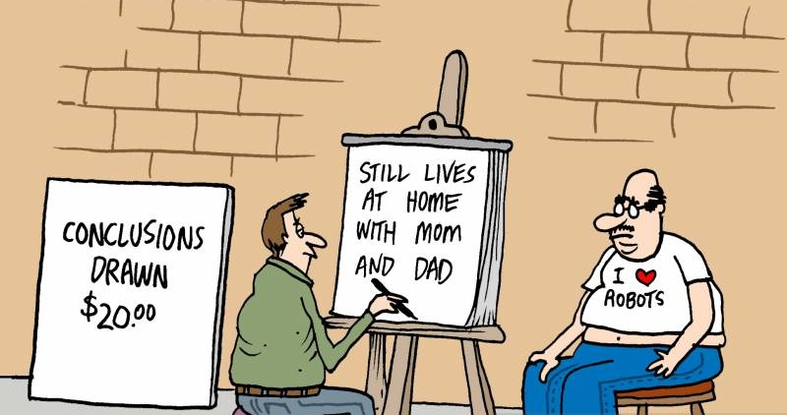
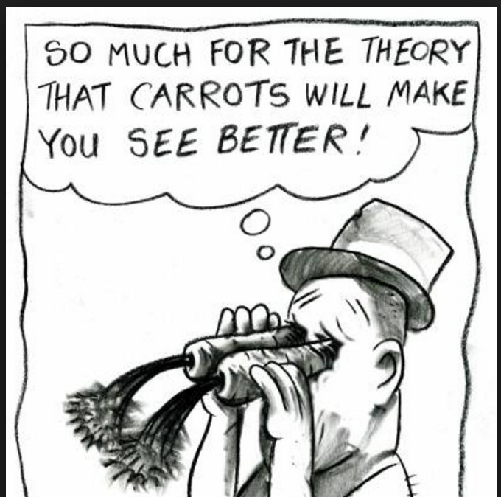

Leaps Of Inference
In the scientific investigation of cooperation and dynamics
Christopher R. Dishop

Slide 2
Leaps Of Inference
In the scientific investigation of cooperation and dynamics
Christopher R. Dishop

Slide 3
Leaps Of Inference
In the scientific investigation of cooperation and dynamics
Christopher R. Dishop

Slide 4
Leaps Of Inference
In the scientific investigation of cooperation and dynamics
Christopher R. Dishop

Slide 5
Agenda

Slide 6
Agenda
- My Domains

Slide 7
Agenda
- My Domains
- The Story of the Sustained Helper

Slide 8

Agenda
Inferential Leap
- My Domains
- The Story of the Sustained Helper

Slide 9
Cooperation
Dynamics

Slide 10
Cooperation
Dynamics

Slide 11
X
Y
t
t + 1
Time
Dynamics

Slide 12
X
Y
t
t + 1
Time
“Mitigates concerns of reverse causality”
Dynamics
“Increases causal certainty”

Slide 13
X
Y
t
t + 1
Time
“Mitigates concerns of reverse causality”
Dynamics
“Increases causal certainty”
Inferential Leap

Slide 14
X
Y
Dishop, C. R., & DeShon, R. P. (In Press). A. tutorial on Bollen and Brand’s approach to modeling dynamics while attending to dynamic panel bias. Psychological Methods.
t
t + 1
Time
“Mitigates concerns of reverse causality”
Dynamics
“Increases causal certainty”
Xu, R., DeShon, R. P., & Dishop, C. R. (2020). Challenges and opportunities in the estimation of dynamic models. Organizational Research Methods, 23(4), 595-619.
Inferential Leap
Dishop, C. R., Braun, M. T., Kuljanin, G., & DeShon, R. P. (2020). Thinking longitudinal: a framework for scientific inferences with temporal data. In Handbook on the Temporal Dynamics of Organizational Behavior. Edward Elgar Publishing.

Slide 15
Cooperation

Slide 16
Dishop, C. R., & DeShon, R. P. (2020). What is the critical mass of help? A potential resolution to a paradox on citizenship and organizational performance. Computational and Mathematical Organization Theory, 1-15.
Cooperation

Slide 17
Dishop, C. R., & DeShon, R. P. (2020). What is the critical mass of help? A potential resolution to a paradox on citizenship and organizational performance. Computational and Mathematical Organization Theory, 1-15.
Cooperation
Single acts of cooperation
“…do not make a dent in the overall performance of the organization…Any single occurrence is usually modest or trivial” (Organ, 1988, p. 8).

Slide 18
Dishop, C. R., & DeShon, R. P. (2020). What is the critical mass of help? A potential resolution to a paradox on citizenship and organizational performance. Computational and Mathematical Organization Theory, 1-15.
Cooperation
Single acts of cooperation
“…do not make a dent in the overall performance of the organization…Any single occurrence is usually modest or trivial” (Organ, 1988, p. 8).
Cooperation improves collective performance only
“…if performed by a sufficient number of individuals” (Organ, 2018, p. 10).

Slide 19
Dishop, C. R., & DeShon, R. P. (2020). What is the critical mass of help? A potential resolution to a paradox on citizenship and organizational performance. Computational and Mathematical Organization Theory, 1-15.
Cooperation
Org
Cooperation
Org
Performance
Single acts of cooperation
“…do not make a dent in the overall performance of the organization…Any single occurrence is usually modest or trivial” (Organ, 1988, p. 8).
Cooperation improves collective performance only
“…if performed by a sufficient number of individuals” (Organ, 2018, p. 10).

Slide 20
Dishop, C. R., & DeShon, R. P. (2020). What is the critical mass of help? A potential resolution to a paradox on citizenship and organizational performance. Computational and Mathematical Organization Theory, 1-15.
Inferential Leap
Cooperation
Org
Cooperation
Org
Performance
Single acts of cooperation
“…do not make a dent in the overall performance of the organization…Any single occurrence is usually modest or trivial” (Organ, 1988, p. 8).
Cooperation improves collective performance only
“…if performed by a sufficient number of individuals” (Organ, 2018, p. 10).

Slide 21

Dishop, C. R., & DeShon, R. P. (2020). What is the critical mass of help? A potential resolution to a paradox on citizenship and organizational performance. Computational and Mathematical Organization Theory, 1-15.
Inferential Leap
Cooperation
Cooperating
Org
Cooperation
Org
Performance
Single acts of cooperation
“…do not make a dent in the overall performance of the organization…Any single occurrence is usually modest or trivial” (Organ, 1988, p. 8).
Cooperation improves collective performance only
“…if performed by a sufficient number of individuals” (Organ, 2018, p. 10).

Slide 22
Dishop, C. R., & DeShon, R. P. (2020). What is the critical mass of help? A potential resolution to a paradox on citizenship and organizational performance. Computational and Mathematical Organization Theory, 1-15.
Inferential Leap
Cooperation
Cooperating
Org
Cooperation
Org
Performance
Single acts of cooperation
“…do not make a dent in the overall performance of the organization…Any single occurrence is usually modest or trivial” (Organ, 1988, p. 8).
Cooperation improves collective performance only
“…if performed by a sufficient number of individuals” (Organ, 2018, p. 10).

Slide 23
Dishop, C. R., & DeShon, R. P. (2020). What is the critical mass of help? A potential resolution to a paradox on citizenship and organizational performance. Computational and Mathematical Organization Theory, 1-15.
Inferential Leap
Cooperation
Cooperating
Org
Cooperation
Org
Performance
Single acts of cooperation
“…do not make a dent in the overall performance of the organization…Any single occurrence is usually modest or trivial” (Organ, 1988, p. 8).
Cooperation improves collective performance only
“…if performed by a sufficient number of individuals” (Organ, 2018, p. 10).

Slide 24
Dishop, C. R., & DeShon, R. P. (2020). What is the critical mass of help? A potential resolution to a paradox on citizenship and organizational performance. Computational and Mathematical Organization Theory, 1-15.
Inferential Leap
Cooperation
Cooperating
Org
Cooperation
Org
Performance
Single acts of cooperation
“…do not make a dent in the overall performance of the organization…Any single occurrence is usually modest or trivial” (Organ, 1988, p. 8).
Cooperation improves collective performance only
“…if performed by a sufficient number of individuals” (Organ, 2018, p. 10).

Slide 25
Dishop, C. R., & DeShon, R. P. (2020). What is the critical mass of help? A potential resolution to a paradox on citizenship and organizational performance. Computational and Mathematical Organization Theory, 1-15.
Inferential Leap
Cooperation
Cooperating
Org
Cooperation
Org
Performance
Single acts of cooperation
“…do not make a dent in the overall performance of the organization…Any single occurrence is usually modest or trivial” (Organ, 1988, p. 8).
Cooperation improves collective performance only
“…if performed by a sufficient number of individuals” (Organ, 2018, p. 10).

Slide 26
Dishop, C. R., & DeShon, R. P. (2020). What is the critical mass of help? A potential resolution to a paradox on citizenship and organizational performance. Computational and Mathematical Organization Theory, 1-15.
Inferential Leap
Cooperation
Cooperating
Org
Cooperation
Org
Performance
Single acts of cooperation
“…do not make a dent in the overall performance of the organization…Any single occurrence is usually modest or trivial” (Organ, 1988, p. 8).
Cooperation improves collective performance only
“…if performed by a sufficient number of individuals” (Organ, 2018, p. 10).

Slide 27
Agenda
Inferential Leap
- My Domains
- The Story of the Sustained Helper

Slide 28

Agenda
Inferential Leap
- My Domains
- The Story of the Sustained Helper

Slide 29

Cooperation
Dynamics

Slide 30
Cooperation
Dynamics

Slide 32
Sustained Help

Slide 33
Sustained Help

Slide 34
Sustained Help

Slide 35
Sustained Help
Helping Behaviors
Time

Slide 36
Sustained Help
Helping Behaviors
Time

Slide 37
Sustained Help
Helping Behaviors
Time

Slide 38
Sustained Help
Helping Behaviors
Time

Slide 39
Sustained Help
Helping Behaviors
Time

Slide 40
Sustained Help
Li et al. 2015
Helping Behaviors
Time

Slide 41
Sustained Help
Li et al. 2015 – “Extra Miler”
Helping Behaviors
Time

Slide 42
Sustained Help
Li et al. 2015 – “Extra Miler”
Methot et al. 2017
Helping Behaviors
Time

Slide 43
Sustained Help
Li et al. 2015 – “Extra Miler”
Methot et al. 2017 – “Good Soldier”
Helping Behaviors
Time

Slide 44

Sustained Help
Li et al. 2015 – “Extra Miler”
Methot et al. 2017 – “Good Soldier”
Grant 2014
Helping Behaviors
Time

Slide 45
Sustained Help
Grant (2014, p. 246) writes:
Of the seventy tellers who were promoted, thirty-three were genuine givers: they sustained their giving after the promotion. The other thirty-seven tellers declined rapidly in their giving.

Slide 46
Sustained Help
Grant (2014, p. 246) writes:
Of the seventy tellers who were promoted, thirty-three were genuine givers: they sustained their giving after the promotion. The other thirty-seven tellers declined rapidly in their giving.

Slide 47
Sustained Help
Grant (2014, p. 246) writes:
Of the seventy tellers who were promoted, thirty-three were genuine givers: they sustained their giving after the promotion. The other thirty-seven tellers declined rapidly in their giving.

Slide 48
Sustained Help
Li et al. 2015 – “Extra Miler”
Methot et al. 2017 – “Good Soldier”
Grant 2014 – “Genuine”
Helping Behaviors
Time

Slide 49


Sustained Help
Li et al. 2015 – “Extra Miler”
Methot et al. 2017 – “Good Soldier”
Driver of Team Performance
Grant 2014 – “Genuine”
Helping Behaviors
Time

Slide 50
Sustained Help
Li et al. 2015 – “Extra Miler”
Methot et al. 2017 – “Good Soldier”
Driver of Team Performance
Grant 2014 – “Genuine”
Helping Behaviors
Time

Slide 51
Sustained Help
Li et al. 2015 – “Extra Miler”
Methot et al. 2017 – “Good Soldier”
Driver of Team Performance
Grant 2014 – “Genuine”
Helping Behaviors
Time
Prosocial Personality & Motives

Slide 52
The story of the
Sustained Helper

Slide 53
Personality and motives

Slide 54
Personality and motives
The environment

Slide 56
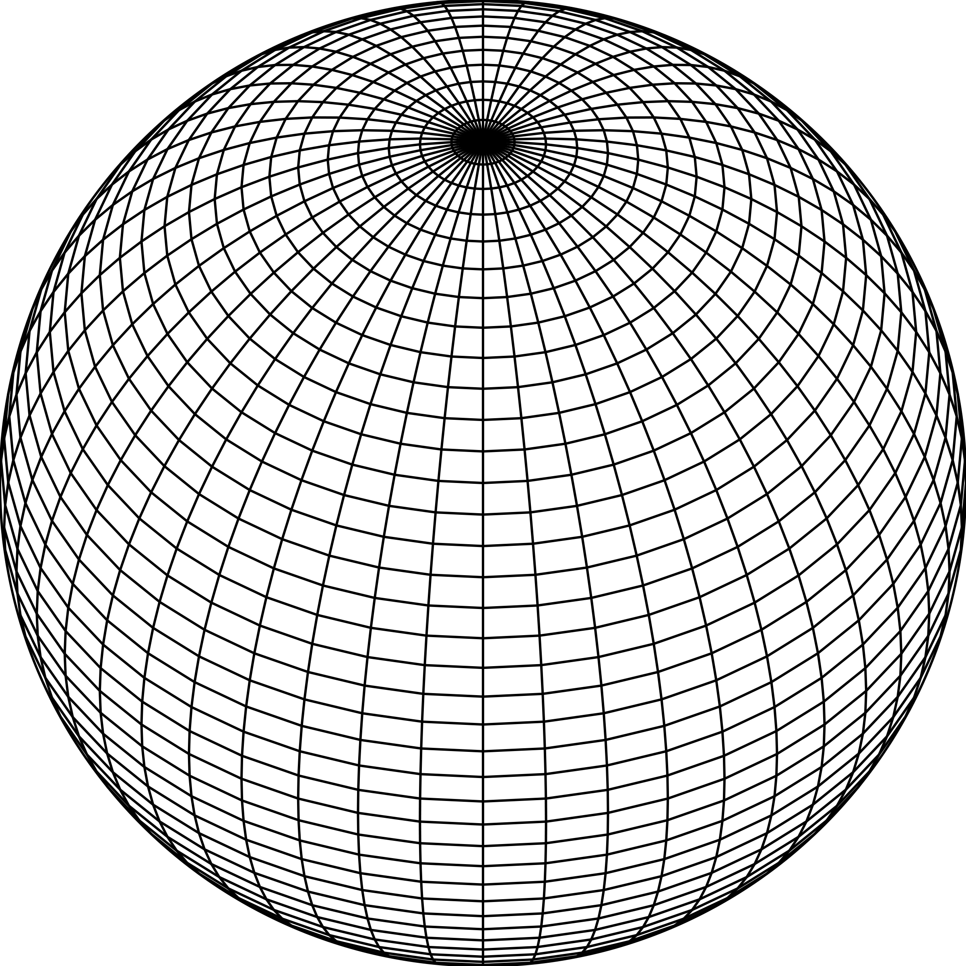
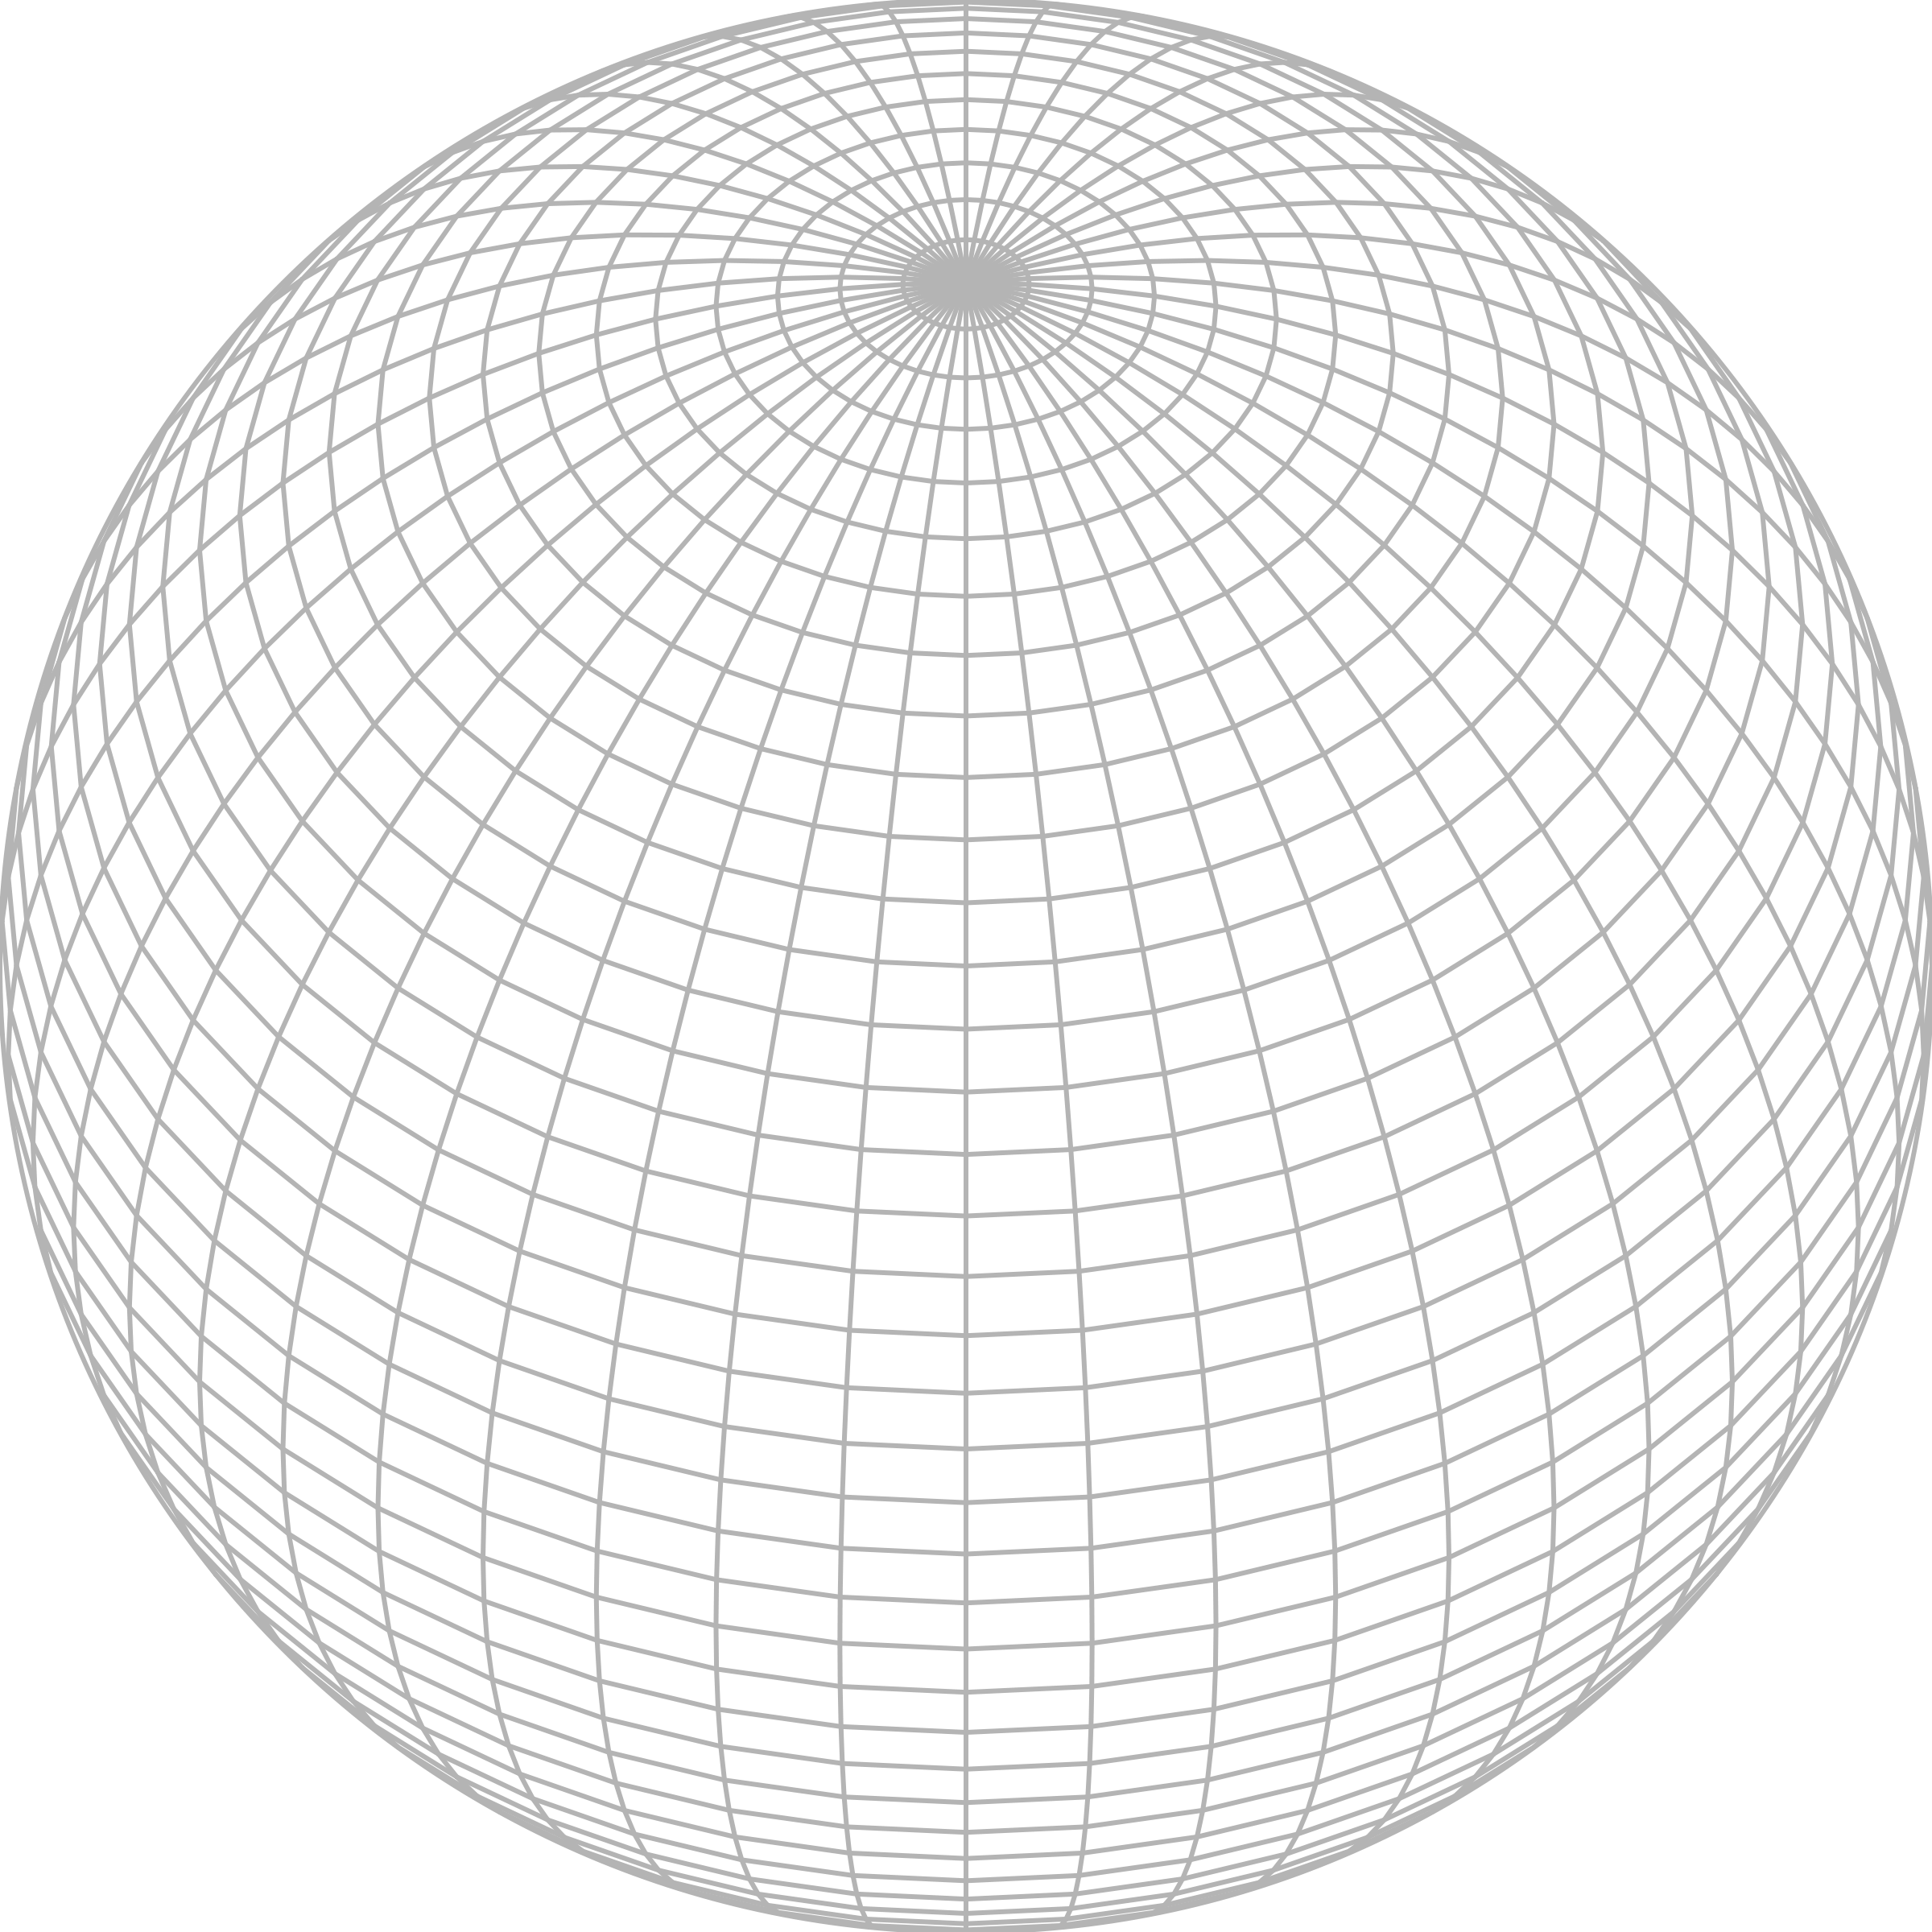

Slide 60
Research Question
- What produces sustained help?

Slide 61
Research Question
- What produces sustained help?
Prior Research
- Prosocial personality & motives

Slide 62
Research Question
- What produces sustained help?
Prior Research
- Prosocial personality & motives
Current Research
- Evidence of uneven situations

Slide 63
Research Question
- What produces sustained help?
Prior Research
- Prosocial personality & motives
Current Research
- Evidence of uneven situations
- Generate sustained help with personality and motives held constant

Slide 64
Insight

Slide 65
Insight
Inferential Leap
- A (behavior) pattern is not evidence of a motive

Slide 66
Research Question
- What produces sustained help?
Prior Research
- Prosocial personality & motives
Current Research
- Evidence of uneven situations
- Generate sustained help with personality and motives held constant

Slide 67
Research Question
- What produces sustained help?
Prior Research
- Prosocial personality & motives
Current Research
- Evidence of uneven situations
- Generate sustained help with personality and motives held constant

Slide 68
Requests

Slide 69
Requests
Help Needed
Is anyone available to cover my undergrad IO class next week? I teach from 12:40-2pm on T/Thr, and next week we’ll cover criterion development and performance appraisal.

Slide 70
Accumulating Requests
Help Needed
Is anyone available to cover my undergrad IO class next week? I teach from 12:40-2pm on T/Thr, and next week we’ll cover criterion development and performance appraisal.

Slide 71
Accumulating Requests

Slide 72
Accumulating Requests

Slide 73
Accumulating Requests
Time

Slide 74
Accumulating Requests
Time

Slide 75
Accumulating Requests
Time

Slide 76
Accumulating Requests
Time

Slide 77
Accumulating Requests
“A surprising amount of prosocial behavior is a compulsory response to a request for help.”
– Cain, Dana, & Newman, 2014
“Most incidents of helping are the direct result of a request for help.”
– Ehrhart, 2018
Time

Slide 78
Accumulating Requests
Time

Slide 79
Accumulating Requests
Time

Slide 80
Accumulating Requests

Slide 81
Accumulating Requests
Sustained lead

Slide 82
Accumulating Requests
Sustained lead
Probability Theory
Random Walks?
If Yes → Sustained Lead

Slide 83
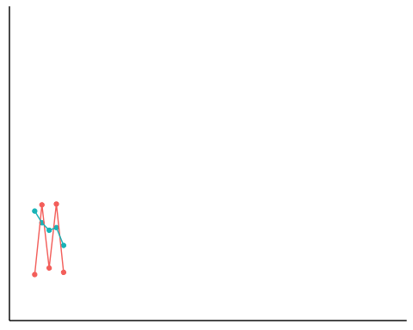
Random Walk
Not A Random Walk
Time

Slide 84
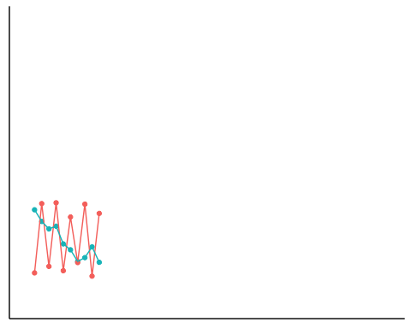
Random Walk
Not A Random Walk
Time

Slide 85
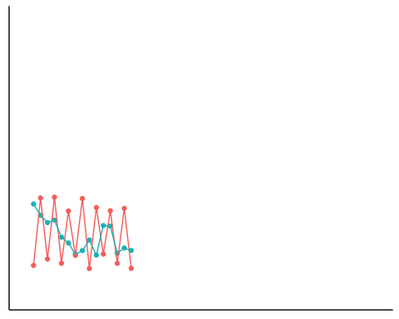
Random Walk
Not A Random Walk
Time

Slide 86
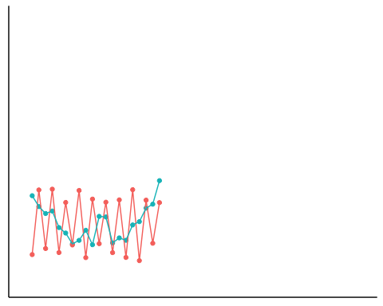
Random Walk
Not A Random Walk
Time

Slide 87
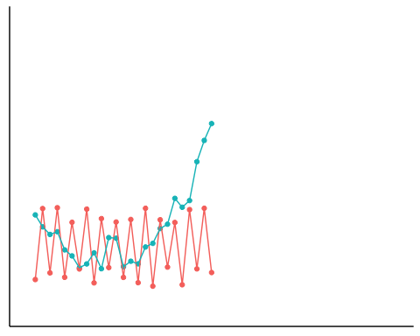
Random Walk
Not A Random Walk
Time

Slide 88
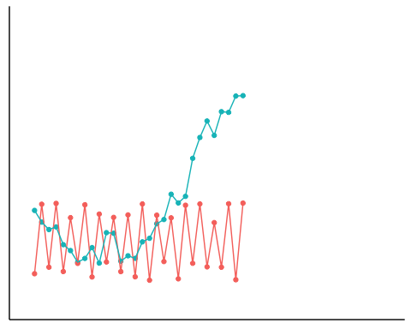
Random Walk
Not A Random Walk
Time

Slide 89
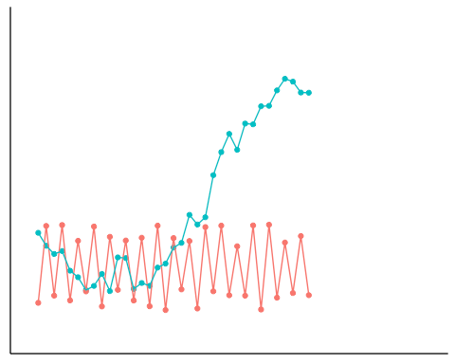
Random Walk
Not A Random Walk
Time

Slide 90
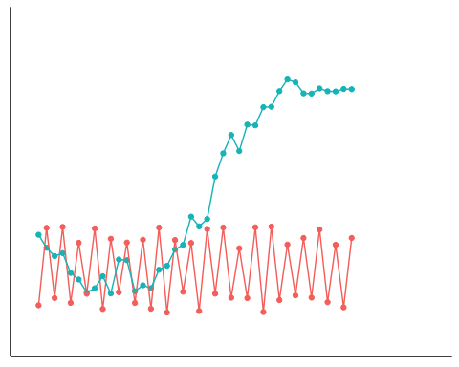
Random Walk
Not A Random Walk
Time

Slide 91
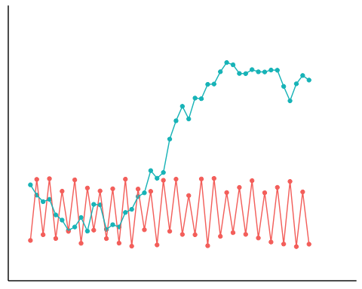
Random Walk
Not A Random Walk
Time

Slide 92
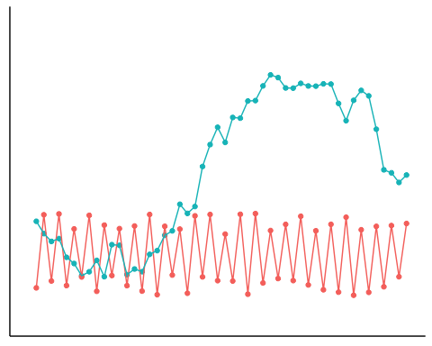
Random Walk
Not A Random Walk
Time

Slide 93
Accumulating Requests
Sustained lead
Probability Theory
Random Walks?
If Yes → Sustained Lead

Slide 94
# of requests for help

Slide 95
# of requests for help

Slide 96
# of requests for help
Time

Slide 97
# of requests for help
Time

Slide 98
# of requests for help
Time

Slide 99
Current Research
- Evidence of uneven situations
- Generate sustained help with personality and motives held constant

Slide 101
Requests

Slide 102
Current Research
- Evidence of uneven situations
- Generate sustained help with personality and motives held constant

Slide 103
Current Research
- Evidence of uneven situations
- Generate sustained help with personality and motives held constant
Requests accumulate as random walks
Sustained lead

Slide 104
Requests – Archival Data

Slide 105
Requests – Archival Data
GitHub

Slide 106
Requests – Archival Data
GitHub (Web Scraping - Landers et al., 2016)

Slide 107
Requests – Archival Data
GitHub (Web Scraping - Landers et al., 2016)
Issue

Slide 108
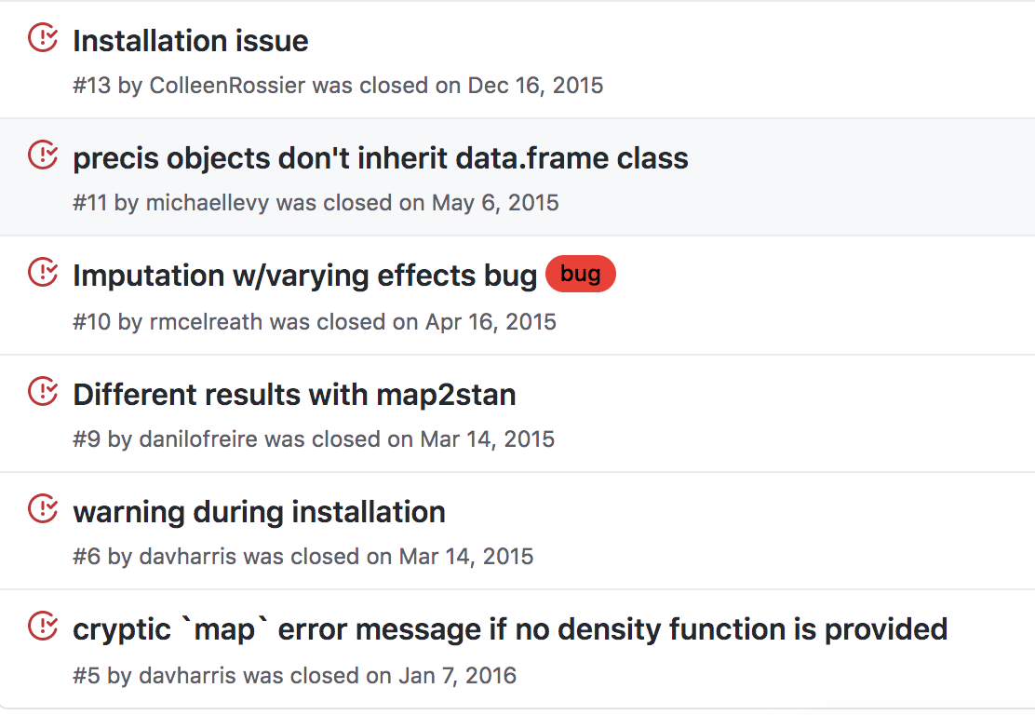
Requests – Archival Data
GitHub (Web Scraping - Landers et al., 2016)
Issue

Slide 109
Requests – Archival Data
GitHub (Web Scraping - Landers et al., 2016)
Issue
# of issues
Time

Slide 110
Requests – Archival Data
GitHub (Web Scraping - Landers et al., 2016)
Issue
Augmented Dickey-Fuller Test (Dickey & Fuller, 1979)

Slide 111
Requests – Archival Data
GitHub (Web Scraping - Landers et al., 2016)
Issue
Augmented Dickey-Fuller Test (Dickey & Fuller, 1979)
35 repositories
559-3373 days

Slide 112
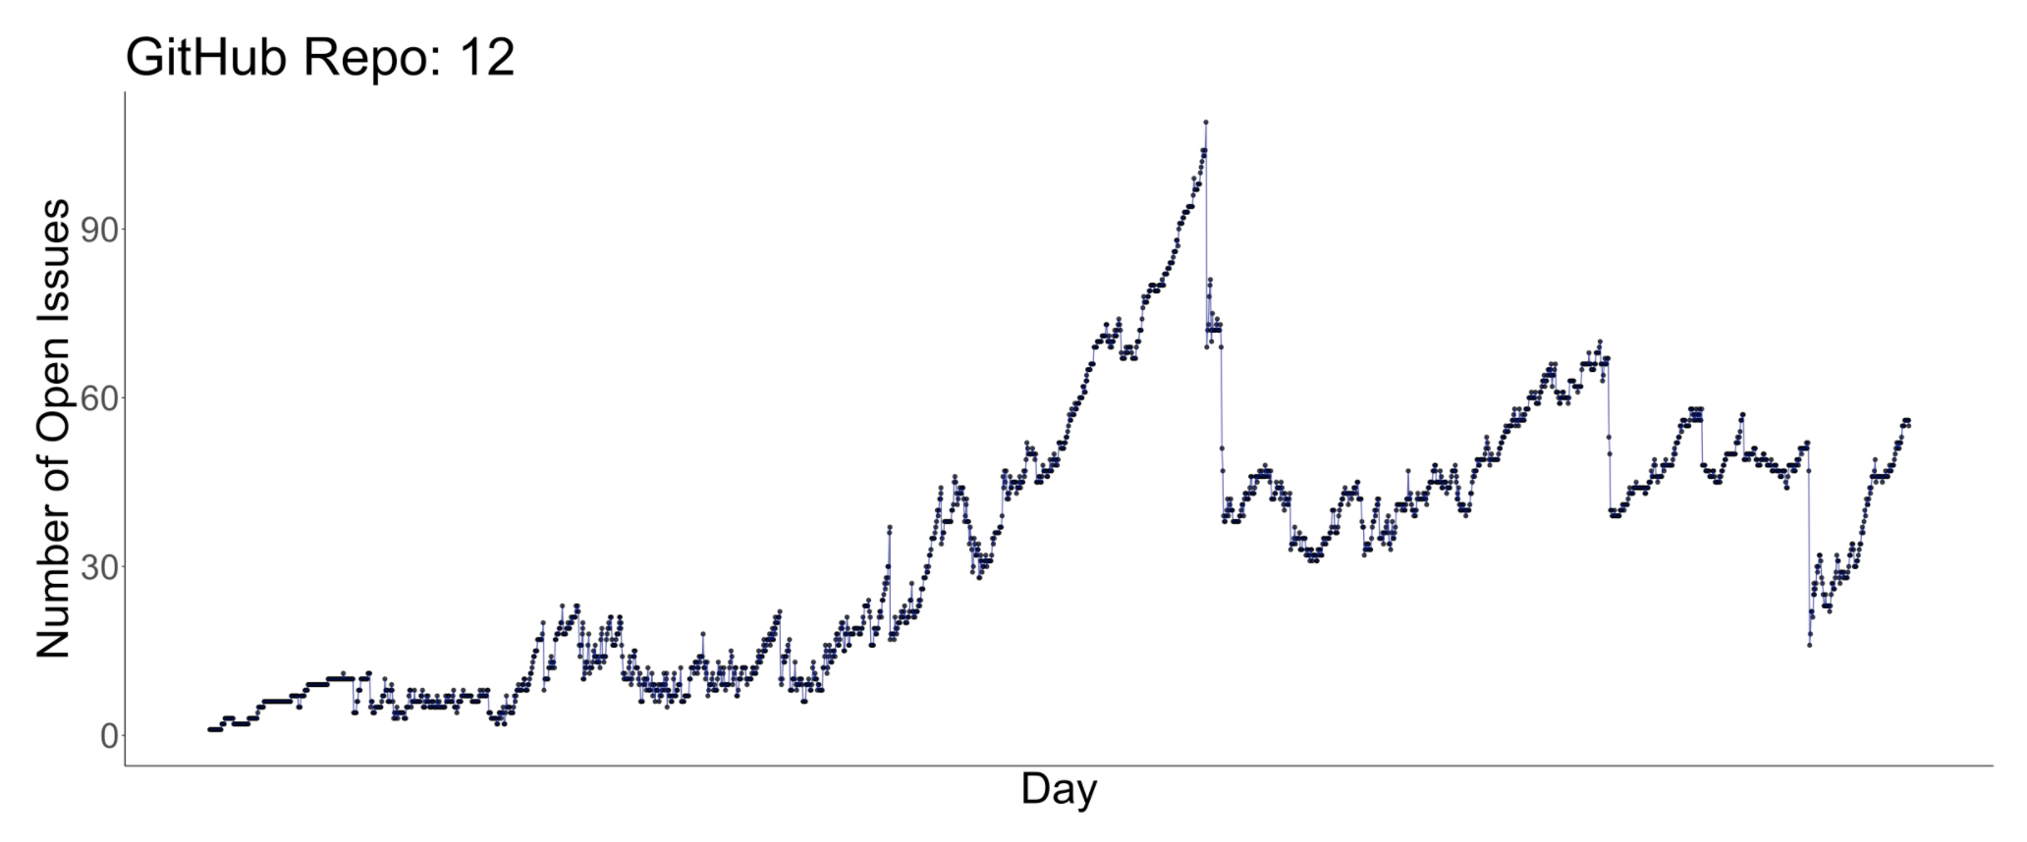
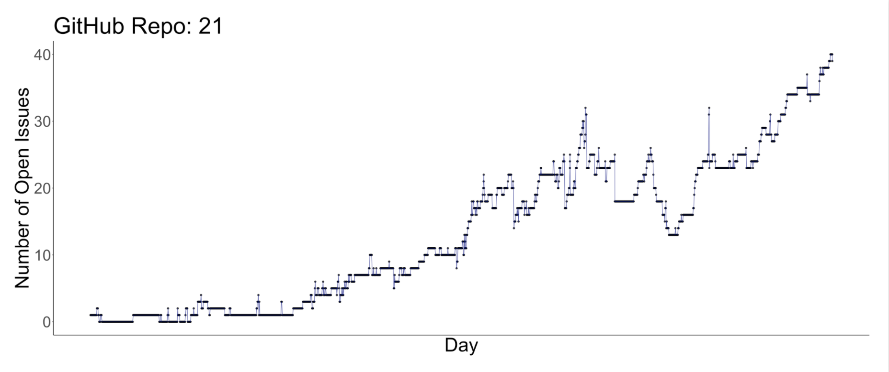
Requests – Random Walks

Slide 113
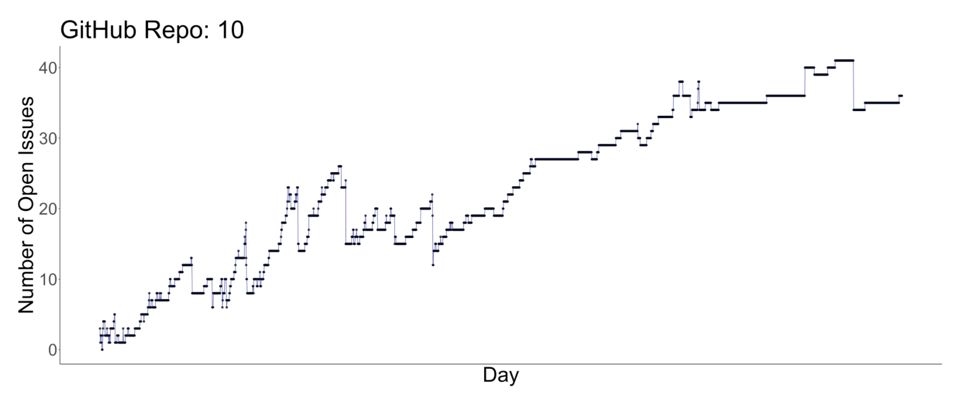
Requests – Random Walks

Slide 114
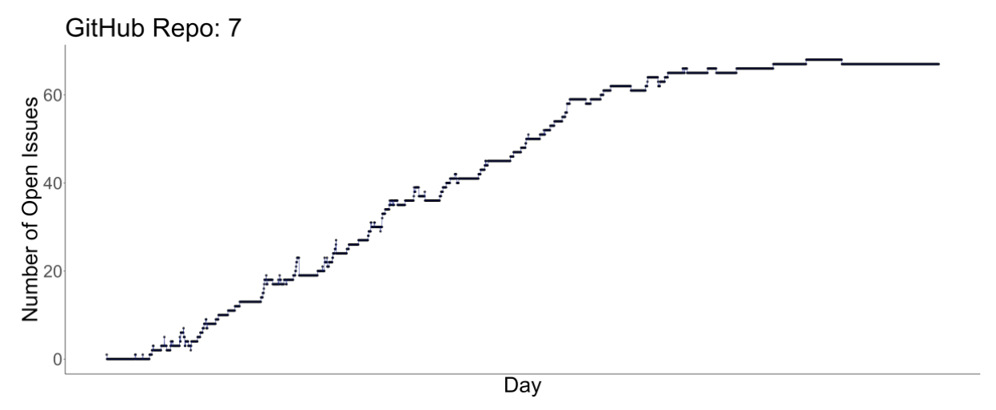
Requests – Random Walks

Slide 115
Requests – Random Walks
ADF = -2.55
ADF = -0.58
ADF = -3.35

Slide 116
Requests – Random Walks
80%
ADF = -2.55
ADF = -0.58
ADF = -3.35

Slide 117
Requests – Sustained Lead

Slide 118
Requests – Sustained Lead
Theoretical
Empirical
Periods Spent In Lead
Periods Spent In Lead

Slide 119
Requests – Sustained Lead
Theoretical
Empirical
Periods Spent In Lead
Periods Spent In Lead

Slide 120
# of requests for help
Time

Slide 121
Requests – Sustained Lead
Theoretical
Empirical
Periods Spent In Lead
Periods Spent In Lead

Slide 122
Requests – Sustained Lead
Theoretical
Empirical
Periods Spent In Lead
Periods Spent In Lead

Slide 123
Periods Spent In Lead
# of requests for help
Time

Slide 124
Periods Spent In Lead
# of requests for help
Time

Slide 125
Requests – Sustained Lead
Theoretical
Empirical
Periods Spent In Lead
Periods Spent In Lead

Slide 126
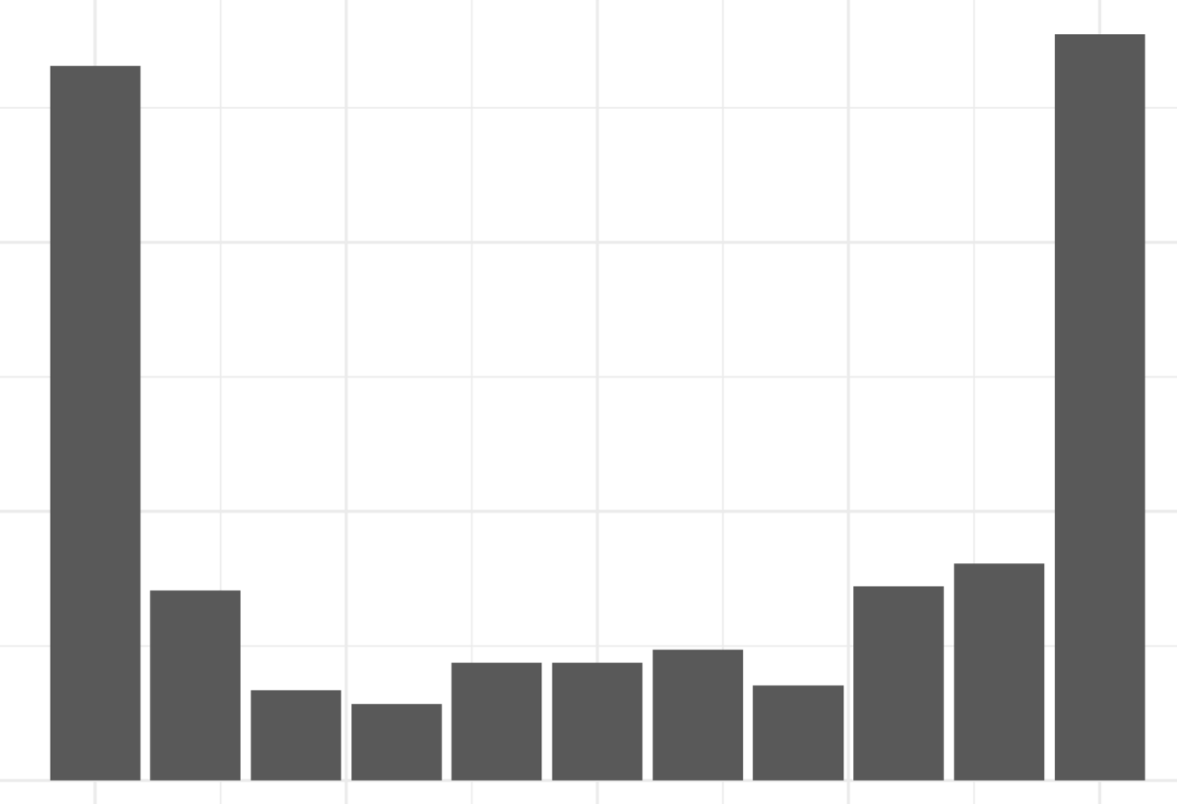
Requests – Sustained Lead
Theoretical
Empirical
Periods Spent In Lead
Periods Spent In Lead

Slide 127
Current Research
- Evidence of uneven situations
- Generate sustained help with personality and motives held constant
Requests accumulate as random walks
Sustained lead

Slide 128
Current Research
- Evidence of uneven situations
- Generate sustained help with personality and motives held constant
Requests accumulate as random walks
Sustained lead

Slide 129
Research Question
- What produces sustained help?
Prior Research
- Prosocial personality & motives
Current Research
- Evidence of uneven situations
- Generate sustained help with personality and motives held constant

Slide 130
Current Research
- Evidence of uneven situations
- Generate sustained help with personality and motives held constant

Slide 131
Current Research
- Evidence of uneven situations
- Generate sustained help with personality and motives held constant

Slide 132
Current Research
- Evidence of uneven situations
- Generate sustained help with personality and motives held constant

Slide 133
Current Research
- Evidence of uneven situations
- Generate sustained help with personality and motives held constant

Slide 134
Current Research
- Evidence of uneven situations
- Generate sustained help with personality and motives held constant
Sustained Help?

Slide 135
Current Research
- Evidence of uneven situations
- Generate sustained help with personality and motives held constant
Criteria:
Sustained Help?

Slide 136
Current Research
- Evidence of uneven situations
- Generate sustained help with personality and motives held constant
Criteria:
Identical dispositions
Sustained Help?

Slide 137
Current Research
- Evidence of uneven situations
- Generate sustained help with personality and motives held constant
Criteria:
Identical dispositions
Manipulate notifications
Sustained Help?

Slide 138
Current Research
- Evidence of uneven situations
- Generate sustained help with personality and motives held constant
Criteria:
Identical dispositions
Manipulate notifications
Over time
Sustained Help?

Slide 139
Current Research
- Evidence of uneven situations
- Generate sustained help with personality and motives held constant
Computational Modeling
Criteria:
Identical dispositions
Manipulate notifications
Over time
✓
✓
✓

Slide 140
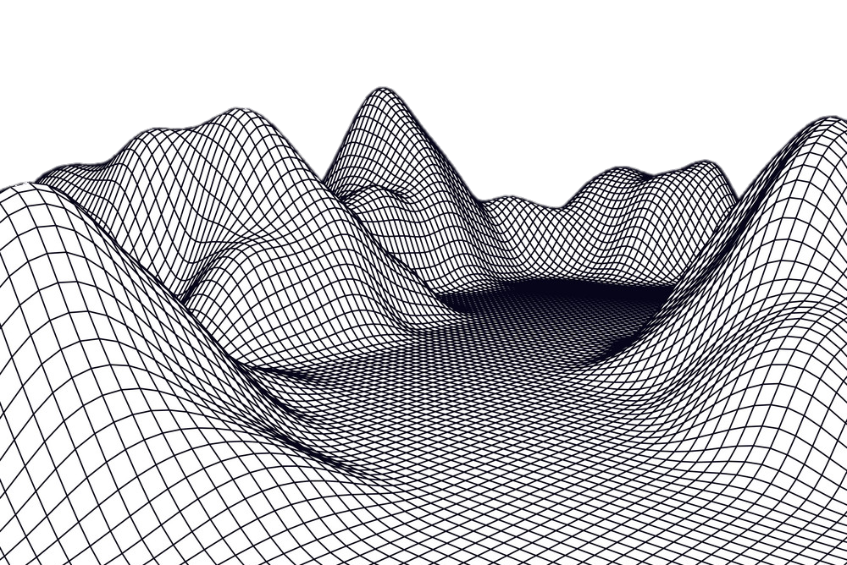

Computational Modeling
Initial Conditions & Environment
Laws of Psychology
Manifest Pattern

Slide 141
Computational Modeling
Initial Conditions & Environment

Slide 142
Computational Modeling
Initial Conditions & Environment
Laws of Psychology

Slide 143
Computational Modeling
Initial Conditions & Environment
Laws of Psychology
Manifest Pattern

Slide 144
Computational Modeling
Criteria:
Identical dispositions
Manipulate notifications
Over time
✓
✓
✓

Slide 145
Computational Modeling
Criteria:
Identical dispositions
Manipulate notifications
Over time
✓
✓
✓

Slide 146
Computational Modeling
Epstein, 2008; Smith & Conrey, 2007; Conte & Paolucci, 2014; Wimsatt, 1987; Smaldino, Calanchini, & Pickett, 2015; Sawyer, 2005
Criteria:
Identical dispositions
Manipulate notifications
Over time
✓
✓
✓

Slide 147
Computational Modeling
Epstein, 2008; Smith & Conrey, 2007; Conte & Paolucci, 2014; Wimsatt, 1987; Smaldino, Calanchini, & Pickett, 2015; Sawyer, 2005
Criteria:
Identical dispositions
Manipulate notifications
Over time
✓
✓
✓
Logical consistency plays a larger role than prediction. How do local rules produce a pattern? The goal is to assess whether a simple set of effects can yield an outcome, not to infer process from observed covariations or to assess the magnitude of one’s R² in a regression model.

Slide 148
Computational Modeling
Epstein, 2008; Smith & Conrey, 2007; Conte & Paolucci, 2014; Wimsatt, 1987; Smaldino, Calanchini, & Pickett, 2015; Sawyer, 2005
If_{(Conditions)}
Then_{(Pattern)}
Logical consistency plays a larger role than prediction. How do local rules produce a pattern? The goal is to assess whether a simple set of effects can yield an outcome, not to infer process from observed covariations or to assess the magnitude of one’s R² in a regression model.

Slide 149
Research Question
- What produces sustained help?
Prior Research
- Prosocial personality & motives
Current Research
- Evidence of uneven situations
- Generate sustained help with personality and motives held constant

Slide 150
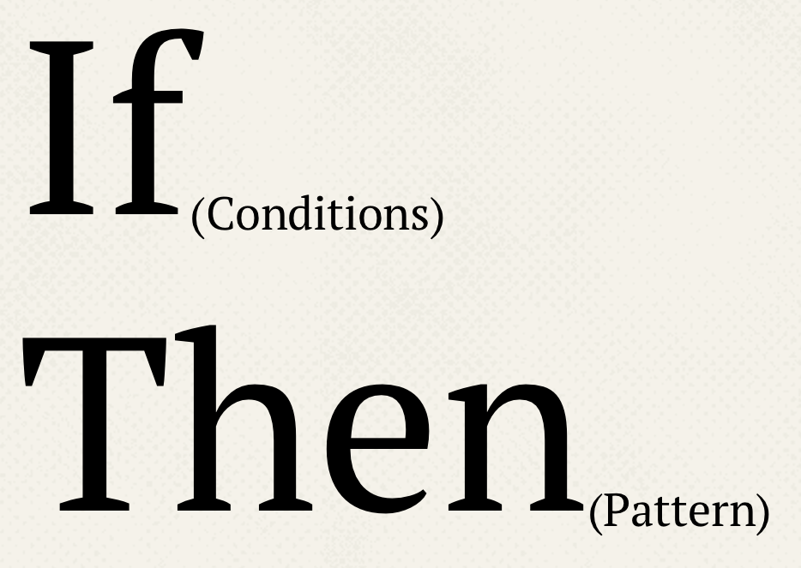
Research Question
- What produces sustained help?
Prior Research
- Prosocial personality & motives
Current Research
- Evidence of uneven situations
- Generate sustained help with personality and motives held constant

Slide 151
Research Question
Domain Knowledge
- What produces sustained help?
Prior Research
- Prosocial personality & motives
Current Research
- Evidence of uneven situations
- Generate sustained help with personality and motives held constant

Slide 152
Situation
Accumulating Requests
Research Question
- What produces sustained help?
Prior Research
- Prosocial personality & motives
Current Research
- Evidence of uneven situations
- Generate sustained help with personality and motives held constant

Slide 153
Situation
Accumulating Requests
Research Question
Person
Cognition
Behavior
- What produces sustained help?
Prior Research
- Prosocial personality & motives
Current Research
- Evidence of uneven situations
- Generate sustained help with personality and motives held constant

Slide 154
Situation
Accumulating Requests
Research Question
Person
Cognition
Behavior
- What produces sustained help?
Control
Personality
Motives
Prior Research
- Prosocial personality & motives
Current Research
- Evidence of uneven situations
- Generate sustained help with personality and motives held constant

Slide 155
Computational Model
Generating Sustained Help

Slide 156


Computational Model
Generating Sustained Help

Slide 157
Computational Model
Generating Sustained Help
300 agents | 20 periods | 10,000 realizations

Slide 158
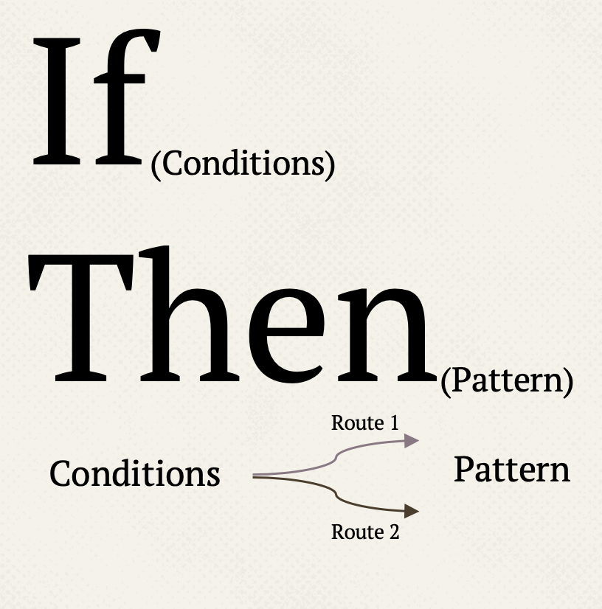
Computational Model
Generating Sustained Help
Situation
Accumulating Requests
Person
Cognition
Behavior
Control
Personality
Motives

Slide 159
Computational Model
Generating Sustained Help
Situation
Accumulating Requests
Person
Cognition
Behavior
Agents receive requests according to a random walk process exhibiting sustained lead
Control
Personality
Motives

Slide 160
Computational Model
Generating Sustained Help
Situation
Accumulating Requests
Person
Cognition
Behavior
Some agents receive more requests than others
Control
Personality
Motives

Slide 161
Computational Model
Generating Sustained Help
Situation
Accumulating Requests
Person
Cognition
Behavior
Some agents receive more requests than others
Requests Accumulate
Control
Personality
Motives

Slide 162
Computational Model
Generating Sustained Help
Situation
Accumulating Requests
Person
Cognition
Behavior
Some agents receive more requests than others
Requests Accumulate
Control
Personality
Motives
Requests Do
Not Accumulate

Slide 163
Computational Model
Generating Sustained Help
Situation
Accumulating Requests
Person
Cognition
Behavior
Some agents receive more requests than others
Requests Accumulate
Control
Personality
Motives
All agents receive similar amounts of requests
Requests Do
Not Accumulate

Slide 164
Computational Model
Generating Sustained Help
Situation
Accumulating Requests
Person
Cognition
Behavior
Control
Personality
Motives

Slide 165
Computational Model
Generating Sustained Help
Lord & Levy, 1994
Powers, 1973
Park, Lim, & Oh, 2019
Chang, Johnson, & Lord, 2009
Hsee & Abelson, 1991
Situation
Accumulating Requests
Help_{it} = f(Number of Requests_{it})
Person
Cognition
Behavior
Control
Personality
Motives

Slide 166
Computational Model
Generating Sustained Help
Lord & Levy, 1994
Powers, 1973
Park, Lim, & Oh, 2019
Chang, Johnson, & Lord, 2009
Hsee & Abelson, 1991
Situation
Accumulating Requests
Help_{it} = f(Number of Requests_{it})
Person
Cognition
Behavior
Respond To Few
Control
Personality
Motives
Help is a negative function of requests
Requests Accumulate
Respond To Many
Help is a positive function of requests
Requests Do
Not Accumulate

Slide 167
Computational Model
Generating Sustained Help
Situation
Accumulating Requests
Person
Cognition
Behavior
Control
Personality
Motives

Slide 168
Computational Model
Generating Sustained Help
Situation
Accumulating Requests
Person
Cognition
Behavior
Control
Personality
Motives

Slide 169
Computational Model
Generating Sustained Help
Situation
Accumulating Requests
Person
Cognition
Behavior
Control
Personality
Motives

Slide 170
Computational Model
Generating Sustained Help
Sustained Help

Slide 171
Computational Model
Generating Sustained Help
Make
It
Formal
Sustained Help

Slide 172
Computational Model
Generating Sustained Help
Make
It
Formal
Sustained Help
Stable Ranks

Slide 173
Computational Model
Generating Sustained Help
Probability of Stable Ranks

Slide 174
Computational Model
Generating Sustained Help
Probability of Stable Ranks
Number of Periods (Time Spent)

Slide 175
Computational Model
Generating Sustained Help
Probability of Stable Ranks
Number of Periods (Time Spent)

Slide 176
Computational Model
Generating Sustained Help
Probability of Stable Ranks
Number of Periods (Time Spent)

Slide 177
Computational Model
Generating Sustained Help
Probability of Stable Ranks
Sustained Help
Number of Periods (Time Spent)

Slide 178
Computational Model
Generating Sustained Help
Respond To Few

Slide 179
Computational Model
Generating Sustained Help
Respond To Few
Requests Accumulate

Slide 180
Computational Model
Generating Sustained Help
Respond To Few
Requests Accumulate
0
20
Number of Periods (Time Spent)

Slide 181
Computational Model
Generating Sustained Help
Respond To Few
0.3
Requests Accumulate
0.0
Probability of Stable Ranks
0
20
Number of Periods (Time Spent)

Slide 182
Computational Model
Generating Sustained Help
Respond To Few
0.3
Requests Accumulate
0.0
Probability of Stable Ranks
0
20
Number of Periods (Time Spent)

Slide 183
Computational Model
Generating Sustained Help
Respond To Few
0.3
Requests Accumulate
0.0
0.3
Probability of Stable Ranks
Requests Do
Not Accumulate
0.0
0
20
Number of Periods (Time Spent)

Slide 184
Computational Model
Generating Sustained Help
Respond To Few
0.3
Requests Accumulate
0.0
0.3
Probability of Stable Ranks
Requests Do
Not Accumulate
0.0
0
20
Number of Periods (Time Spent)

Slide 185
Computational Model
Generating Sustained Help
Respond To Few
Respond To Many
0.3
Requests Accumulate
0.0
0.3
Probability of Stable Ranks
Requests Do
Not Accumulate
0.0
0
20
0
20
Number of Periods (Time Spent)

Slide 186
Computational Model
Generating Sustained Help
Respond To Few
Respond To Many
0.3
Requests Accumulate
0.0
0.3
Probability of Stable Ranks
Requests Do
Not Accumulate
0.0
0
20
0
20
Number of Periods (Time Spent)

Slide 187
Current Research
- Evidence of uneven situations
- Generate sustained help with personality and motives held constant

Slide 188
Current Research
- Evidence of uneven situations
- Generate sustained help with personality and motives held constant

Slide 189
Current Research
- Evidence of uneven situations
- Generate sustained help with personality and motives held constant
Grant 2014

Slide 190
Grant (2014) writes:
Of the seventy tellers who were promoted, thirty-three were genuine givers: they sustained their giving after the promotion. The other thirty-seven tellers declined rapidly in their giving. They were fakers: in the three months before the promotion, they went out of their way to help others. But after they got promoted, they reduced their giving by an average of 23 percent each. p 246.

Slide 191
Grant (2014) writes:
Of the seventy tellers who were promoted, thirty-three were genuine givers: they sustained their giving after the promotion. The other thirty-seven tellers declined rapidly in their giving. They were fakers: in the three months before the promotion, they went out of their way to help others. But after they got promoted, they reduced their giving by an average of 23 percent each. p 246.

Slide 192
Grant (2014) writes:
Of the seventy tellers who were promoted, thirty-three were genuine givers: they sustained their giving after the promotion. The other thirty-seven tellers declined rapidly in their giving. They were fakers: in the three months before the promotion, they went out of their way to help others. But after they got promoted, they reduced their giving by an average of 23 percent each. p 246.

Slide 193
Grant (2014) writes:
Of the seventy tellers who were promoted, thirty-three were genuine givers: they sustained their giving after the promotion. The other thirty-seven tellers declined rapidly in their giving. They were fakers: in the three months before the promotion, they went out of their way to help others. But after they got promoted, they reduced their giving by an average of 23 percent each. p 246.

Slide 194
Grant (2014) writes:
Of the seventy tellers who were promoted, thirty-three were genuine givers: they sustained their giving after the promotion. The other thirty-seven tellers declined rapidly in their giving. They were fakers: in the three months before the promotion, they went out of their way to help others. But after they got promoted, they reduced their giving by an average of 23 percent each. p 246.

Slide 195
Insight
Inferential Leap
- A (behavior) pattern is not evidence of a motive

Slide 196
Personality and motives
The environment

Slide 197
Agenda
Inferential Leap
- My Domains
- The Story of the Sustained Helper

Slide 198
What’s Next?

Slide 199
What’s Next?
Synergy:
When you and I work together, we can (potentially) achieve more than what either of us could have accomplished on our own

Slide 200
What’s Next?
Synergy:
When you and I work together, we can (potentially) achieve more than what either of us could have accomplished on our own
Star Performers

Slide 201
What’s Next?
Synergy:
When you and I work together, we can (potentially) achieve more than what either of us could have accomplished on our own
Star Performers
Patterns In Observed Data
Data Generating Mechanisms

Slide 202
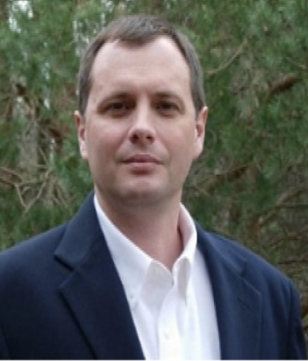

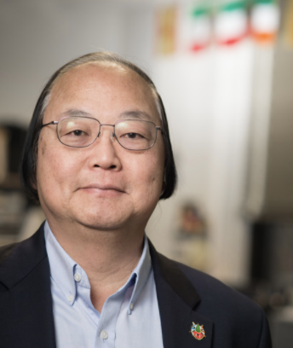

Thanks!
Rick DeShon, PhD
Ann Marie Ryan, PhD
Fred Leong, PhD
Nick Hays, PhD

Slide 203
dishopch@msu.edu
https://cdishop.github.io/diss.appendix/
(takes a second to load =)

Slide 204
Extra

Slide 205
Moderators
OCB autocorrelation
Interdependence
Removal of notifications after help
Conformity
…to similar levels?
…equivalent changes?

Slide 206
Employees React To Size

Slide 207
Employees React To Change

Slide 208
Employees React To Norms

Slide 209
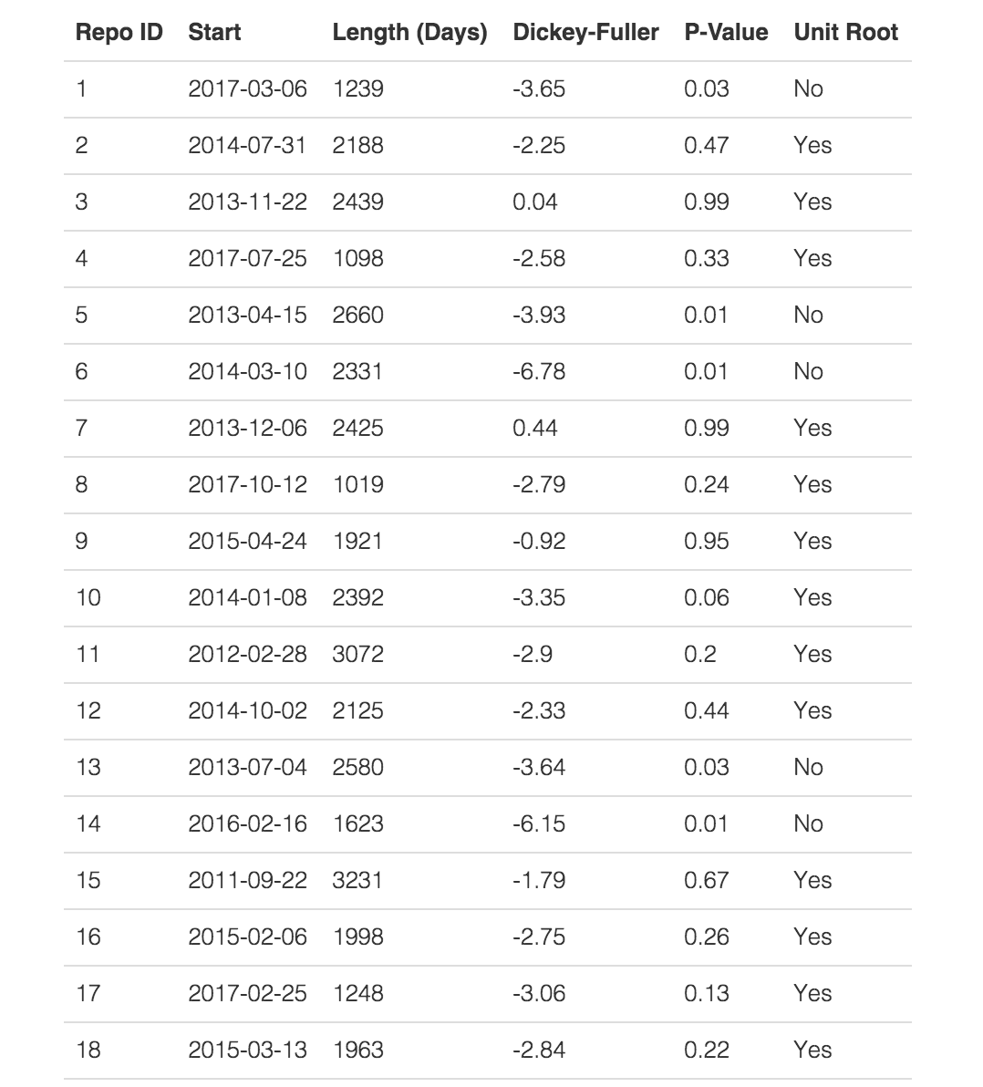

Slide 210
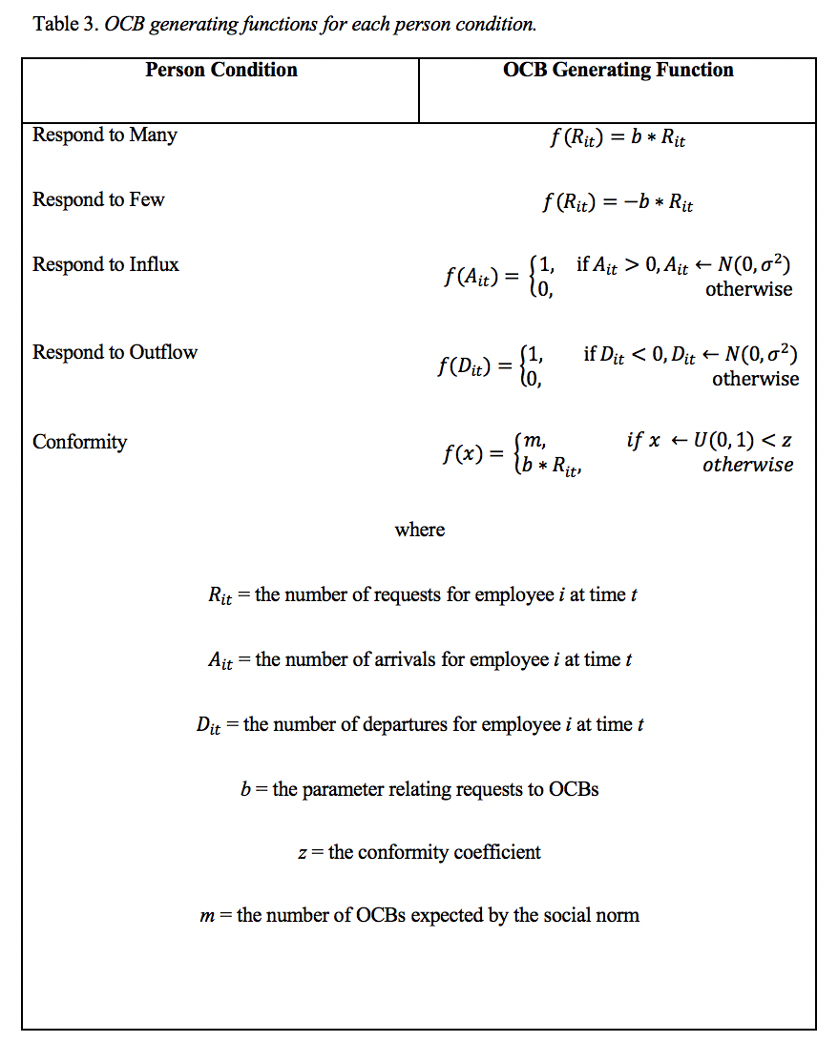

Slide 211
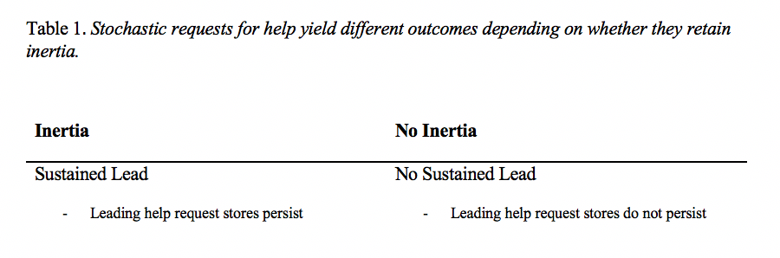

Slide 212
Is it really OCB if it follows a request? (1)
Li, Frese, & Haider, 2018
Low proactive, High OCB = “person reacts to pleas for help but does not volunteer help”
Smith, Organ, Near, 1983
“Many forms of OCB occur after a stimulus that appears to be situational, that is, someone has a problem, needs assistance, or requests a service”
Newton & LePine, 2018
“…respond to opportunities to help a coworker”
“…respond to a request for information with courtesy”

Slide 213
GitHub Repo Issues 1
Issues can be removed or resolved on GitHub due any number of reasons. For example, the individual who posts it may figure out the problem on his or her own. If this happens, he or she can follow-up the original issue with another notification. It is also possible for the repository owner to respond and then close the issue. Alternatively, a “bystander” – someone who did not post the issue nor did he or she create the repo but happened to come across the public system of notifications for any number of reasons (one being that he or she uses the code within the repository and so actively follows it) – can send his or her own response. For any or all of these reasons, requests can be resolved. Of course, it is also possible for them to lay dormant indefinitely. Following suggestions from Landers et al. (2016), both academic and non-academic repositories were included because it is possible to view various types of repository activity either as in-role or extra-role behavior. Podsakoff, Morrison, and Martinez (2018) also note that the boundaries of citizenship are sometimes blurry because employees may believe certain behaviors to be in-role even though they are not part of a job description (and vice versa). Prior literature on OCBs among academics, for instance, has differentiated in-role research activity from behaviors focused on contributing to one’s broader profession (Bergeron, Ostroff, Schroeder, & Block, 2014).

Slide 214
GitHub Repo Issues 2
After scraping but prior to converting the data into a time-series format for analysis, the data were checked against my assumptions (Landers et al., 2016). My first assumption was that the data would offer observations with high frequency over long periods of time. This assumption was met (see Results for descriptives). I also assumed that repository owners would receive issues from other individuals. This assumption was partially met. I noticed that, occasionally, a repository owner would post an issue him or herself and subsequently respond – a web behavior that I had not planned for. Out of all data points gathered, self-created issues happened 11% of the time. Landers et al. (2016) recommended selecting cases that are consistent with one’s data-source theory and removing inconsistencies if they occur infrequently. Self-created issues, therefore, were not included in the final data set. Only issues posted by non-owners of the repository counted toward a help request trajectory. Keep in mind that selecting cases that are representative of one’s data-source theory is different from carelessly creating missing data (Newman, 2014).

Slide 215
GitHub Repo Demographics
Germany, Belgium, United States, Brazil, London
9 Academics
R/Julia/Python statistical package…
26 Non-Academics
Software Developers
Plugin that allows screenshots
Minimal programming language
Application for correcting errors in console

Slide 216
Example GitHub Issue
https://github.com/rmcelreath/rethinking/issues/15

Slide 217
Why Random Walks? (…and not social capital)
Two Mechanisms of Sustained Lead
Random School of Thought
Systematic School of Thought

Slide 218
Why Random Walks? (…and not social capital)
1) Demonstrate “Unsystematic”
”Other authors have argued that instability in the presumed causes of citizenship lead to instability in citizenship itself. The current study suggests that, even when an underlying cause of citizenship is unsystematic, the observed pattern may still exhibit systematic patterns.”
2) Inertia (Delay) & Chance? -> Random Walk
3) Identical Predictions
”Cumulative advantage and social capital offer reasons for why some individuals may experience greater or fewer requests than others. It is not a contradiction to say that, at a lower level of analysis, cumulative advantage and social capital may explain why some are afforded more requests than others while, at a higher level of analysis, observed requests trajectories exhibit random movement. Both could occur. This research simply started with trajectory movement and offered downstream consequences. Others may glean insight by going lower and instead focusing on upstream causes of movement. Another consistency is that, in terms of downstream consequences, cumulative advantage and social capital offer identical predictions to those presented here.”

Slide 219
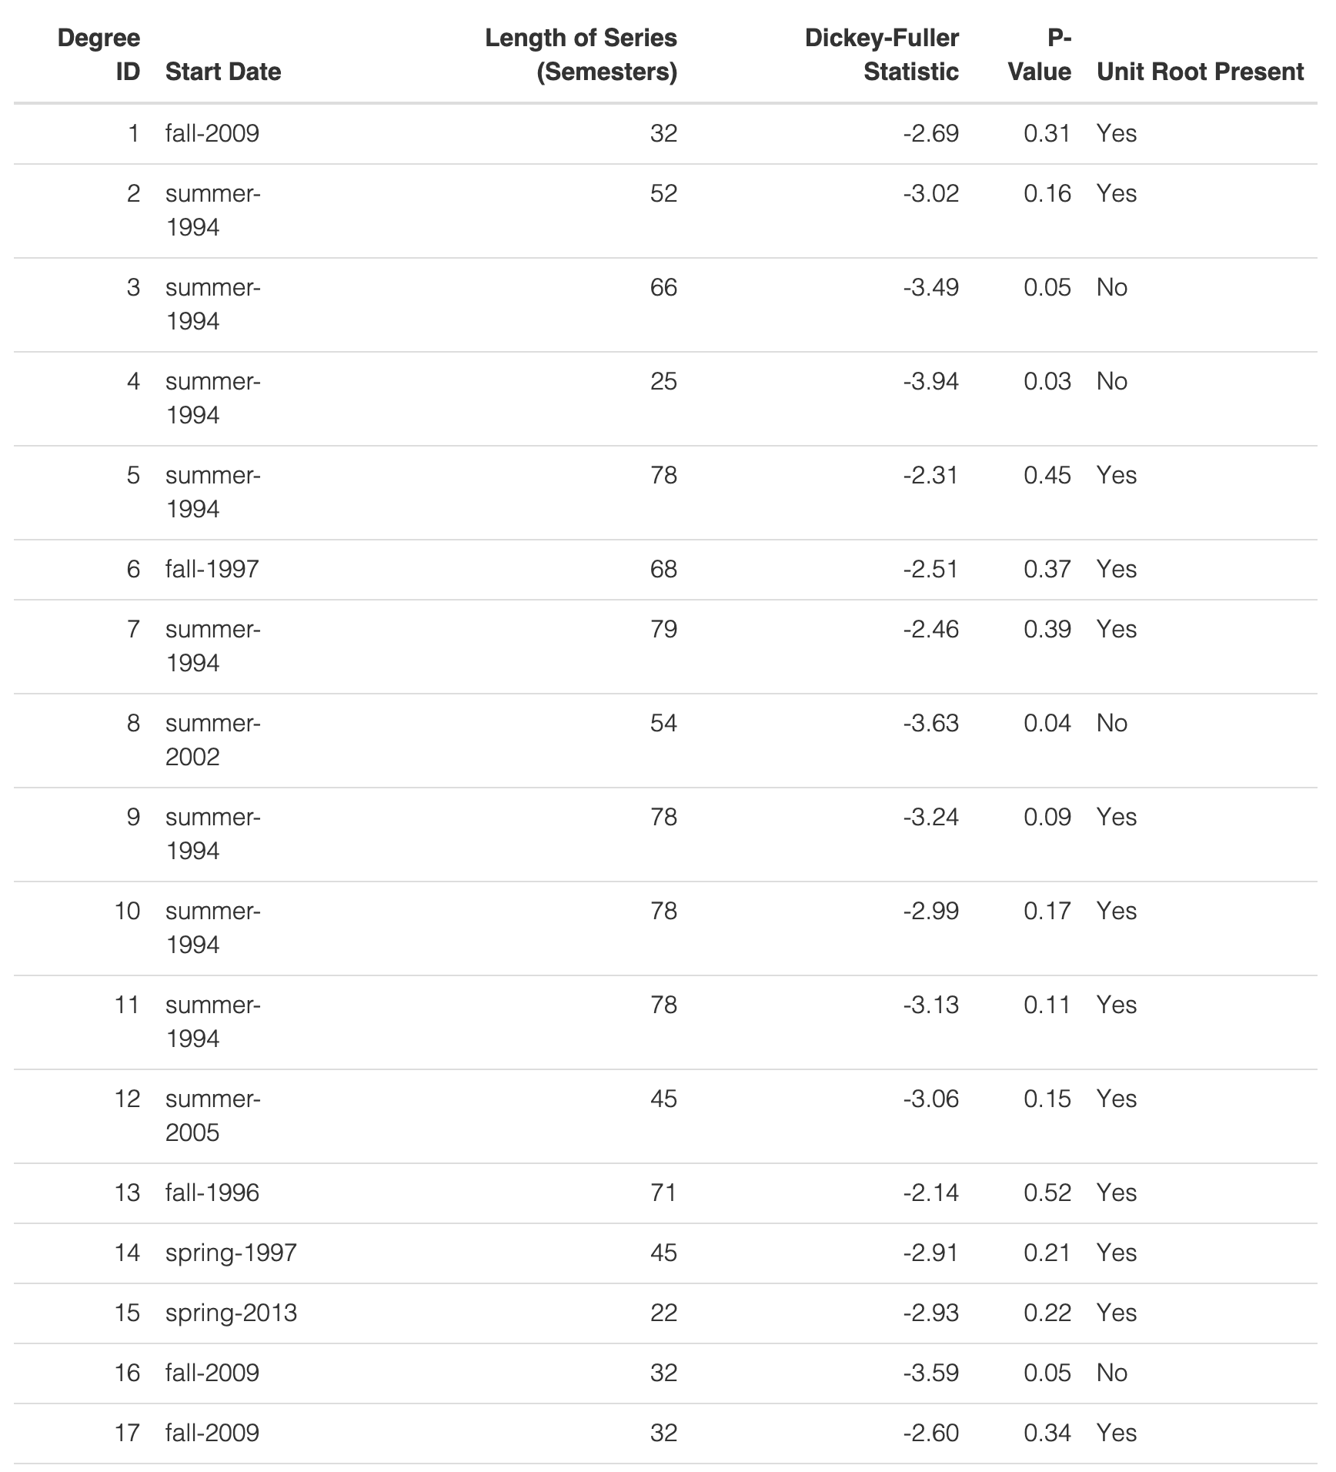
More Data – MSU Grad Programs
N series = 92
77% Consistent with Random Walk

Slide 220
RWs in I/O Articles
Few examine the extent to which random patterns exist in their data. When randomness goes unevaluated, then arguments for systematic causes are untenable. To expand on this point, I conducted a brief review of articles published in the Journal of Applied Psychology (JAP), Organizational Behavior and Human Decision Processes (OBHDP), and the Academy of Management Journal (AMJ). Articles were collected from the start of 2019 until August 10th, 2020. For JAP, this search resulted in 180 papers (8 issues). For AMJ, this search resulted in 96 papers (10 issues). For OBHDP, 87 papers (10 volumes) were collected. All 363 studies were examined. I gathered descriptives on each study's collected data and marked whether unit root, stationarity, or random walk procedures were undertaken. Ninety-three of the articles collected data across 3 or more waves. Of those, none evaluated the presence of unit roots in their series. One can also observe little appreciation for randomness in psychological/organizational behavior textbooks on longitudinal data analysis. Among some of the more popular titles (e.g., Bolger & Laurenceau, 2013; Bollen & Curran, 2006; Grimm, Ram, & Estabrook, 2017; Hoffman, 2015; Singer & Willett, 2003), there are no chapters describing stochastic processes like those presented in this article. The reverse is true in economics (e.g., Croissant, 2018; Racine, 2019; Wooldridge, 2013). All of the cited books, which are by no means unique, have one or more chapters on unit root testing, stochastic processes, random walks, and stationarity. The take-away from this (small) review is that randomness sits unevaluated in our literature. The world may be systematic, but much of our longitudinal research has not ruled out random causes. This paper offers theoretical insight into the downstream consequences that randomness can lead to, especially when it is paired with inertia.

Slide 221
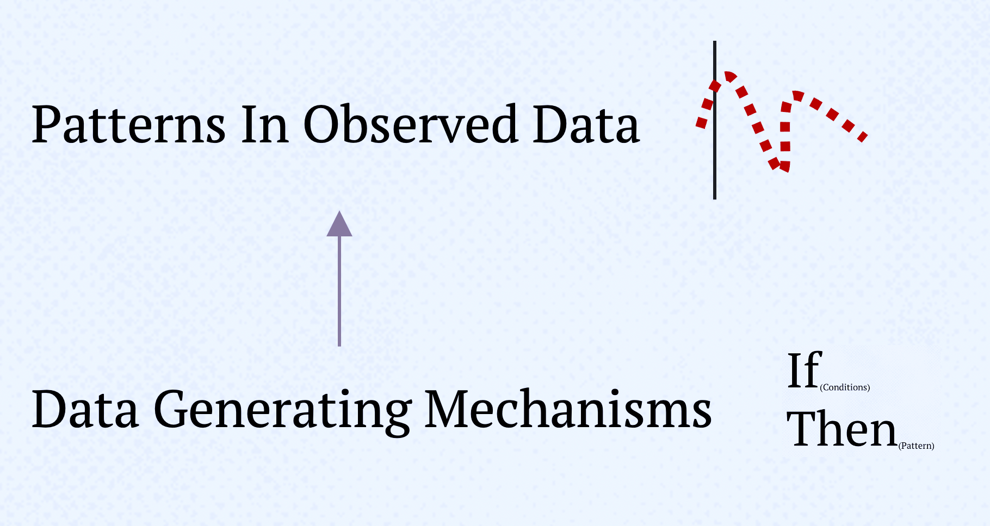
Fundamental Attribution Error
Current Research
FAE
Patterns In Observed Data
Data Generating Mechanisms

Slide 222
Requests From Org Outsiders
1) Academic & Non-Academic
Academic = “outside” org
Non-academic (free-lance software) = “inside” org
2) Bergeron et al., 2014
University, internal OCBs
Serve on committees
Attend major student events
Act like a peacemaker when departments disagree
“Touch base” with other faculty
Attend major student events to show support for the institution
Professional service OCBs
Serve as a discussant or chair at professional meeting
Serve as an officer for a professional association
Organize a meeting at professional association
Serve on journal editorial board

